Slide 1


Careers
YEAR 11 –
Submitting applications
Image by PostiveSteps@16
RMA Careers vision – To raise the aspirations of all Rushey Mead Academy students to enable them to make a positive difference to our world.

Slide 2
Important Information
Careers
If you are applying to Leicester College, you will need to log in to the Leicester College Learner hub as well as PS16. When you send your application on PS16, this will generate Leicester College sending you details on how to log in to the Learner Hub. This will be sent to your personal email address.
If you are applying to Loughborough College – there are now 4 different campuses (see next slide for more details) for BTEC courses and T Levels, make sure that you know which campus you are applying for. Can you get to and from the campus by public transport. Use Google Maps to check. You can apply to Loughborough College direct through the college, but you must also apply on PS16.
RMA Careers vision – To raise the aspirations of all Rushey Mead Academy students to enable them to make a positive difference to our world.
Notes:
Teacher: Important college information relating to Leicester College Learner hub and the effects of the merger between Loughborough College and SMB College.

Slide 3
Important Information about Loughborough College
Loughborough College have now combined with SMB College, As such, Loughborough College Group now has multiple campuses:
Loughborough College: Located on Radmoor Road -main campus offering a wide range of courses. A level courses will continue to be hosted at this campus.
Brooksby College: A specialist campus for land-based, equine (horse-related), and sports courses, located in Melton Mowbray. It features an 850-acre site with a working farm, an Equine Centre, and state-of-the-art sports facilities.
Stephenson College: Situated in Coalville, this campus focuses on technical trades, engineering, construction, and motor vehicle technology, with industry-standard workshops.
Ignite (Melton Campus): Located in Melton Mowbray, this campus is dedicated to performing arts, with facilities that include a commercial performance space called Melton Theatre.
Notes:
Teacher: When students view courses on PS16, they can see which campus the course applies to.

Slide 4
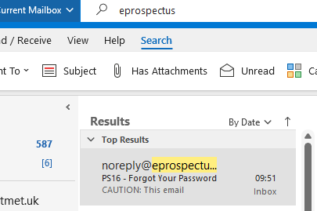
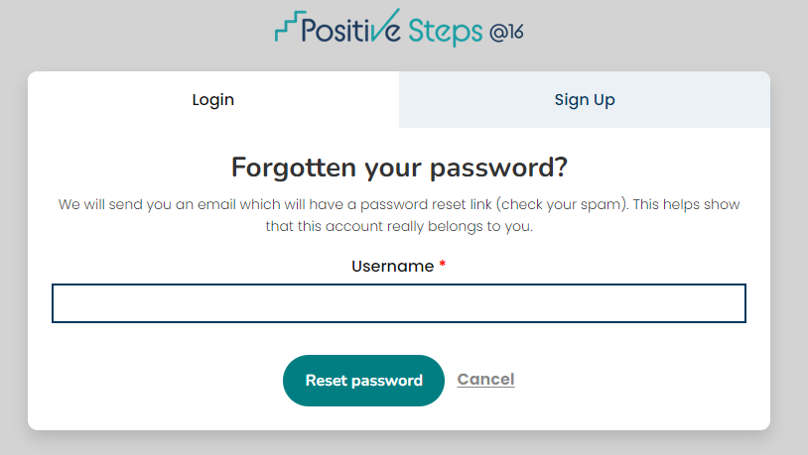
PS16, college & course information.
Careers
You will need to log in to ‘Your Account’ on PS16 and check that you have completed the profile.
To find your PS16 email – go to search and type in eprospectus. Your email will be from noreply@eprospectus.co.uk
If you cannot log in, reset your password with your username, check your outlook for an email from eprospectus and log in.
RMA Careers vision – To raise the aspirations of all Rushey Mead Academy students to enable them to make a positive difference to our world.
Notes:
Teacher – Students can access the links to PS16 and Outlook on their ‘Student portal’ on the Rushey Mead website. They need to scroll down to ‘Load more posts’ to find it. If needed, please demonstrate to students Student Portal – Rushey Mead Academy | TMET Leicester MAT

Slide 5
PS16, college & course information.
Are you ready to submit your applications or do you need to wait for your Autumn predicted grades?
Careers
You are ready to submit your applications now if: -
Do you already have the grades required for the course or courses?
Are you CONFIDENT that your grades will not drop?
If you can say YES to both of these questions – you are ready to submit your applications. From the next slide, you will find out how to do this.
If your grades are borderline (only just match the entry requirements) or you are hoping that one or more of your grades will improve enough to match the entry requirements of your chosen course/courses – Do NOT submit now! Wait until you receive your Autumn termly tracking predicted grades. Remember, if you are not sure, come to B145.
There are 2 stages to submitting your application on PS16: -
Stage 1 - Choosing the course or courses you want to study, adding them and giving your reasons for your choice.
Stage 2 – Review and send your application
BOTH stages must be completed to successfully submit your applications to your colleges on PS16.
Notes:
Teacher – Are you ready to submit your applications? Read the slide and the 2 stage application process details

Slide 6
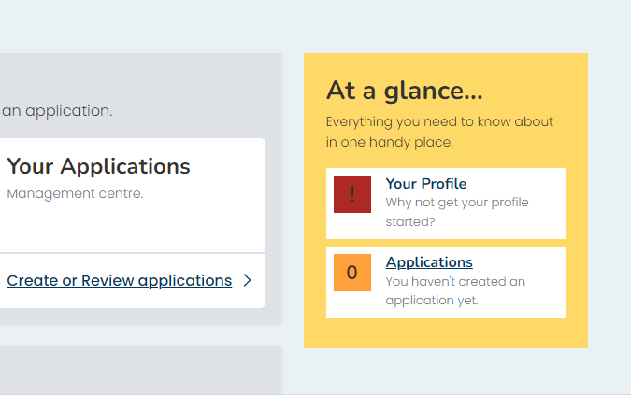
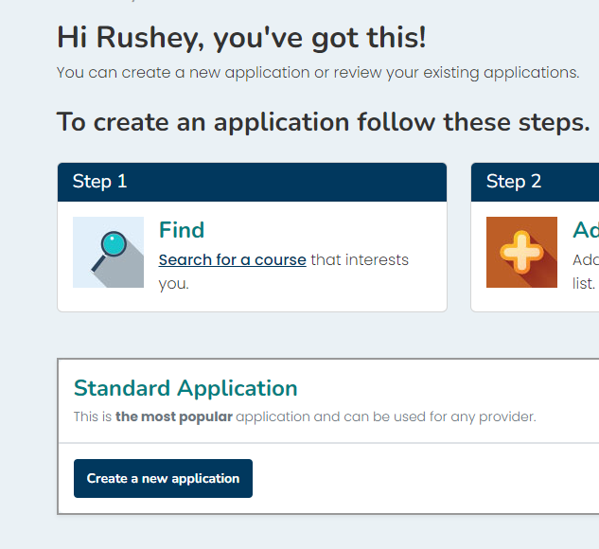
PS16, college & course information.
Submitting applications on PS16
Careers
Submitting Applications Stage 1 –
In ‘Your Account, click on ‘Create or Review Applications or At A Glance… Applications.
Then click ‘Create a new application’.
Notes:
Teacher – Submitting applications Stage 1 – students begin stage 1 by clicking on ‘create or review applications, then click on Standard Application – Create a new application.

Slide 7
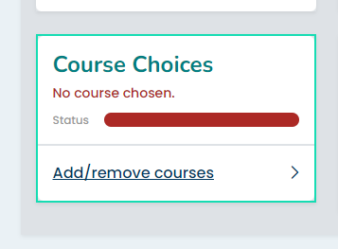
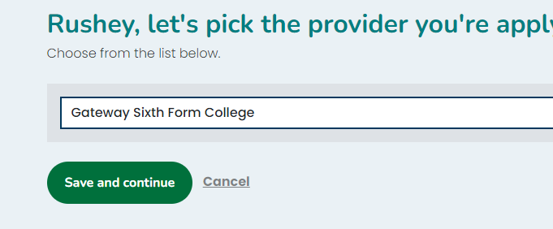
PS16, college & course information.
Submitting applications on PS16
Careers
Click on the dropdown to select the college/training provider and Save & Continue
Next click on course choices – Add/remove courses
Notes:
Teacher – Select the college, save and continue, then click to Add courses

Slide 8
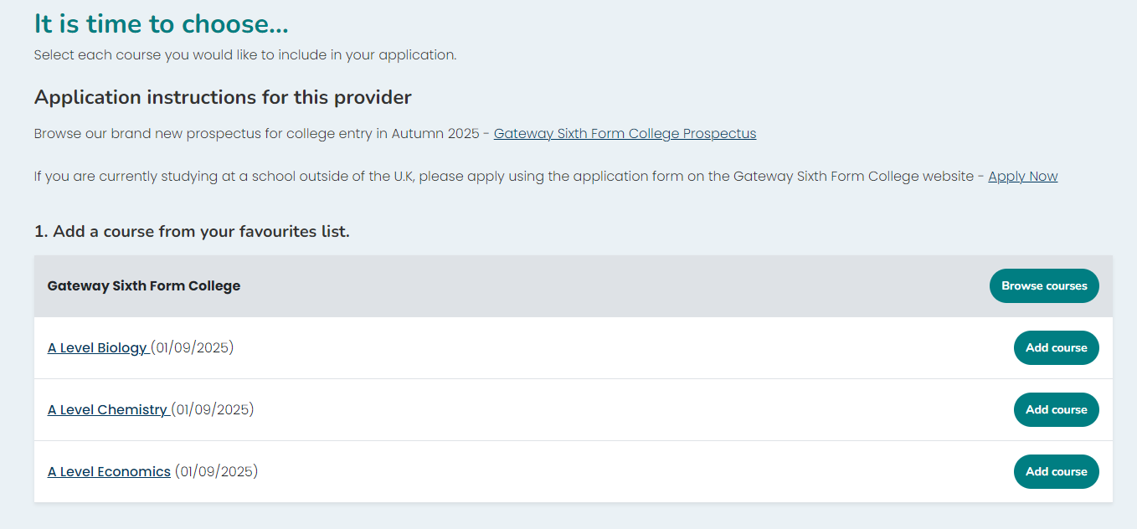
PS16, college & course information.
Submitting applications on PS16
Careers
Now, click to add courses
Do NOT apply for a mixture of Level 1, 2 & 3 courses.
You will be applying for either
1 x Level 1 course (if you have 1s & 2s in your grades)
Or
1 x Level 2 course (if you have mainly 3s in your grades)
Or
1 x Level 3 course if T level or BTEC extended diploma (if you have 4s and above in your grades – CHECK INDIVIDUAL ENTRY REQUIREMENTS)
OR
3 x A level courses (if you have between 2 and 6 x grade 5s including Maths & English Language - CHECK INDIVIDUAL ENTRY REQUIREMENTS
Please note that the Criminology college is equal to 1 x A level only
Only WQE offers smaller BTEC courses which enable you to mix and match with other smaller BTEC courses or A levels to make the equivalent of 3 x A levels
Notes:
Teacher – Add each course separately. Once they have been added, you will have the opportunity to add a sentence to say why you have chosen these courses.

Slide 9
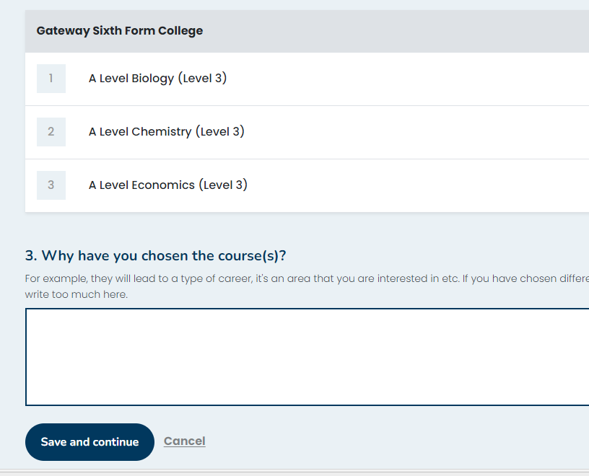
PS16, college & course information.
Submitting applications on PS16
Careers
Once you have added all 3 x A levels or 1 x BTEC extended diploma or 1 x T level or 1 x Level 1 or Level 2 course, you can then complete the box – Why have you chosen the course(s).
You just need 1 sentence in this box: -
I have chosen this course/these courses because …
I think I will enjoy it/them.
I am interested in this course/courses.
This course/these courses are linked to career areas that I am interested in.
Click to ‘Save and continue’
Notes:
Teacher – Here you need to put a short explanation to state why you have chosen the course or courses (1 short sentence is enough), then click Save & Continue

Slide 10
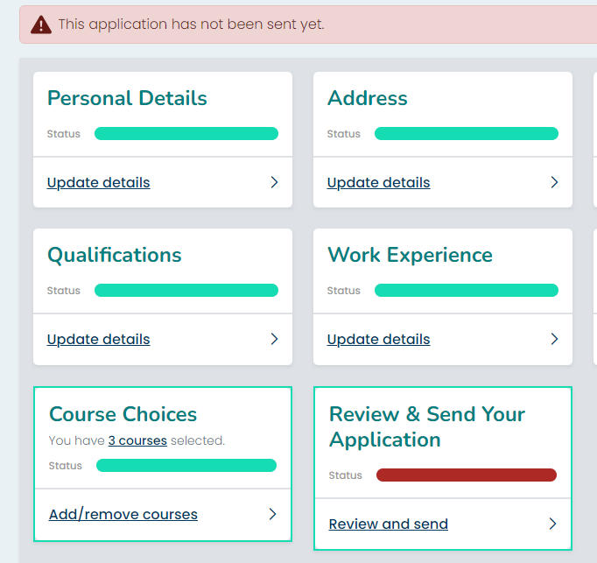
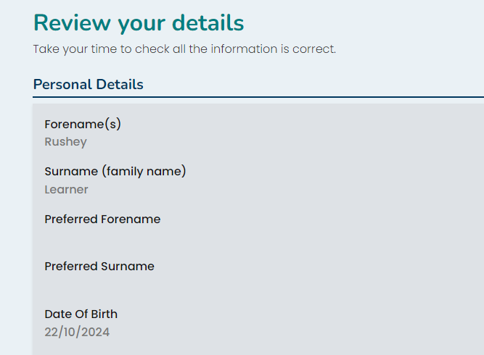
PS16, college & course information.
Submitting applications on PS16
Careers
Submitting Applications Stage 2 –
You now need to ‘Review and send your application’.
Scroll down and check that all your information is correct – this will be your chance to edit your personal details before you send your application.
Notes:
Teacher – Stage 2 - Your application has not been sent yet – you need to click ‘Review and send your application’.

Slide 11
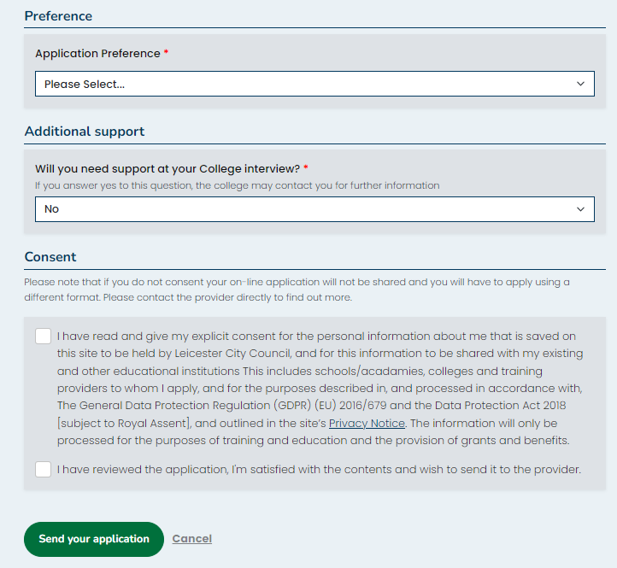
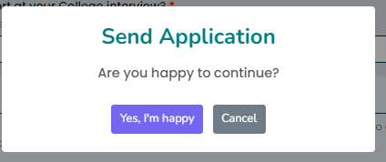
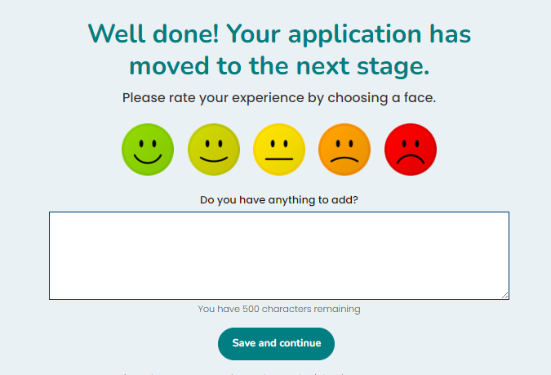
PS16, college & course information.
Submitting applications on PS16
Careers
Submitting Applications Stage 2 –
Scroll down and answer questions from the college if there are any, select your ‘application preference’ , read and tick both consent boxes, and click to ‘Submit your application’
Click on ‘Yes, I’m Happy
Choose your smiley face and add a comment if you want to. Click ‘save & continue’.
Notes:
Teacher – Students need to scroll down to check their personal information is correct, make changes if needed, and answer questions from colleges towards the end. (Checking personal information only needs to be done on the first application) The application preference is a dropdown with 1 being first choice, 2 being second and so on.

Slide 12
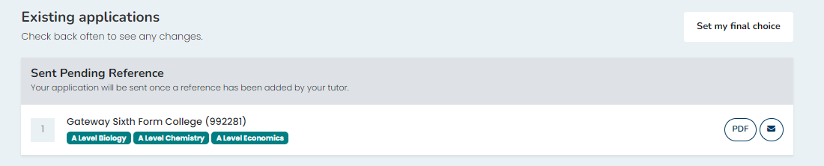
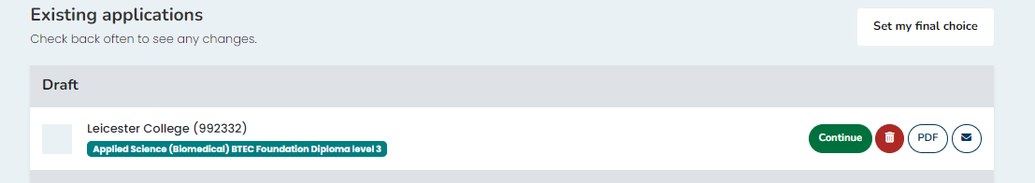
PS16, college & course information.
Submitting applications on PS16
Careers
Submitting Applications Stage 2
Your application will now show as ‘Sent pending reference’.
Submitting Applications Stage 2
If your application is shown as draft, you have completed Stage 1 of the application process and must complete stage 2 to submit your application
Notes:
Teacher – This is how the application will look once sent, if it is still showing as Draft, you need to click on continue to finish submitting your application.

