Slide 1


Careers
YEAR 9 –Parent Information
RMA Careers vision – To raise the aspirations of all Rushey Mead Academy students to enable them to make a positive difference to our world.
Image by rawpixel.com on Freepik
Notes:
Welcome parents to a short presentation about what the Careers team can offer your child in Year 11 and how you can support them with their college applications

Slide 2
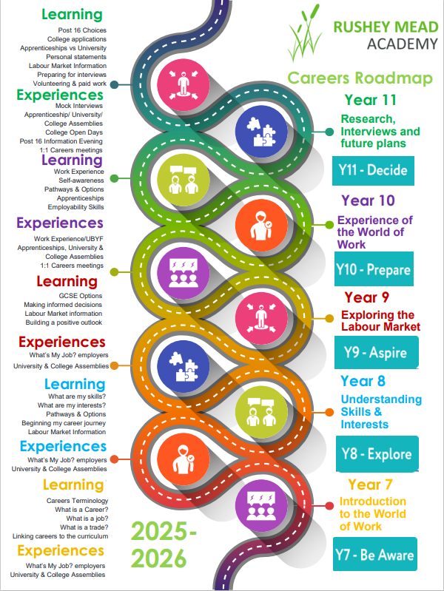
Why is careers education important?
Encouraging student aspirations
Enabling students to make well informed decisions about GCSE options, post 16 choices and possible careers through careers education, advice & guidance.
Linking what happens at school to future careers goals.
Encouraging personal development,
Careers
RMA Careers vision – To raise the aspirations of all Rushey Mead Academy students to enable them to make a positive difference to our world.
Notes:
If your child has not yet had their meeting, please don’t worry. We have over 300 students in Year 11 so it will take some time.

Slide 3
What we offer students: -
Regular tutor time careers lessons for all year groups and accompanying careers workbooks to build a strong foundation of careers education.
Careers assemblies across all year groups about college, university and apprenticeships.
Work Experience in Year 10 – we are introducing work experience opportunities for students in KS3, planning to start with Year 8 students.
Mock interviews in Year 11 to improve student communication and confidence.
Every student has a 1:1 meeting in KS4 with a qualified careers adviser.
All students have access to the Careers team in B145 at break or lunchtime for information and guidance.
Careers
RMA Careers vision – To raise the aspirations of all Rushey Mead Academy students to enable them to make a positive difference to our world.
Notes:
If your child has not yet had their meeting, please don’t worry. We have over 300 students in Year 11 so it will take some time.

Slide 4
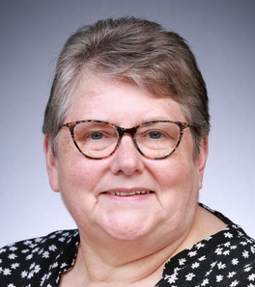
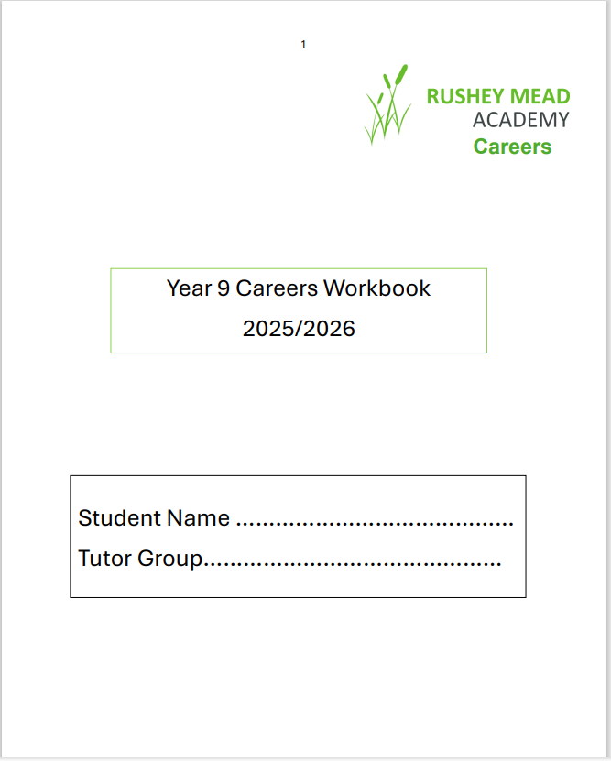
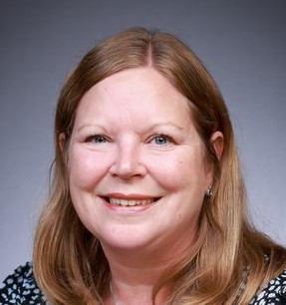
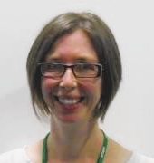
The Careers Team
What we offer Year 9 students: -
Regular termly tutor time careers lessons throughout the year.
Students can email the team – careers@rushey-tmet.uk if they have any questions about careers.
Our office is B145 - students are welcome to come and see us for additional help and support at break or lunchtime.
A Careers workbook to complete during the tutor time careers lessons to prepare students for choosing options and future study/career choices.
We are in the planning stage to be able to offer students in KS3 mini work experience opportunities – to be implemented over the next 2 years.
Careers
Mrs Butler
Careers Lead
Mrs Sewell
Careers Adviser
Mrs Mee
Careers Adviser
RMA Careers vision – To raise the aspirations of all Rushey Mead Academy students to enable them to make a positive difference to our world.
Notes:
If your child has not yet had their meeting, please don’t worry. We have over 300 students in Year 11 so it will take some time.

Slide 5
What we cover in the tutor time careers lessons – Year 9 Aspire
Careers
Options – linking subjects to courses & careers
LMI – what is it and what does it mean for me?
Decision making – choosing what to study in KS4
What are my skills
Managing Money
The importance and benefits of being a lifelong learner
We offer unbiased information, advice and guidance to enable your child to make their own fully informed decision about their future after Rushey Mead Academy
What different routes are available to you
Setting targets
RMA Careers vision – To raise the aspirations of all Rushey Mead Academy students to enable them to make a positive difference to our world,

Slide 6

Advice for deciding which options to choose in Year 9
Careers
In Year 9 students will be offered 2 option choices to study in Year 10
Options include: - Art, Photography, Design Technology, Drama, Food & Nutrition, Music, Physical Education & Health& Social Care
Other options are: - Computer Science, Geography, History, Economics & Media
Students need to study these subjects if they want to continue studying them after Rushey Mead at college: - Art, Design, Photography, PE, Food, Drama, Dance, Music
Students do not need to have studied these subjects at Rushey Mead if they want to study them at college: - Computer Science, Economics, Media, Health & Social Care
Students considering the academic route of A levels at college will be guided towards studying either History or Geography.
Image by rawpixel.com on Freepik
RMA Careers vision – To raise the aspirations of all Rushey Mead Academy students to enable them to make a positive difference to our world.

Slide 7
Advantages of studying History and/or Geography
History is a challenging subject that requires a good memory for dates and issues, and an analytical mind. You learn to question the reliability of sources, which makes it good for developing critical thinking skills that will be essential once you get to university. We all live in a volatile, dynamic, and interconnected world. Knowledge of the past is essential in understanding and trying to make sense of what's happening now. GCSE History helps us to do both, through studying key events and individuals from the past and the ways in which they have shaped our present.
Every student studies the equivalent of 7 or 8 GCSEs at Rushey Mead BEFORE they add their options. They already study a wide range of subjects which will enable them to study A levels at college if they achieve the grades required.
Geography is the study of the shape and features of the Earth's surface, including countries, vegetation, climates, how humans use the world's resources and the environmental impact that humans have on these resources. This is a subject gaining more importance and momentum due to the issues arising from climate change and our need to protect our environment. Geography provides students with the knowledge and transferable skills that will reward them personally and assist their personal development.
Careers
Image by rawpixel.com on Freepik
RMA Careers vision – To raise the aspirations of all Rushey Mead Academy students to enable them to make a positive difference to our world.

Slide 8

Encouraging good habits now
Careers
Maths & English GCSEs
Attendance matters – aim for 90% plus - evidence shows that the students with the highest attendance at school achieve the best GCSE and A level results
Punctuality – on time, every time to school and lessons – not only is it disruptive to tutor time and lessons if your child arrives late but it interrupts your child’s learning
Homework – This is important as it helps embed a student’s learning
Behaviour in lessons
Work/Life Balance – Encourage your child to have activities outside of their studies – after school clubs are available at Rushey Mead
Talk to your child about their schoolwork so that you can support them if they become worried about it
Image by freepik
RMA Careers vision – To raise the aspirations of all Rushey Mead Academy students to enable them to make a positive difference to our world.
Notes:
Maths & English GCSEs – if students do not achieve 4s by the time they leave Rushey Mead, they will need to retake these GCSEs at college alongside their course/courses/Attendance – starting good habits of attending regularly now will make it easier for students to continue this pattern in years 10 & 11.

Slide 9





Labour Market Information and Pathways
Leicester and Leicestershire
Notes:
This presentation can be delivered in approximately 30 minutes. Please contact anna.scull@llbsp.org.uk if you would like support delivering it for the first time to parents and carers. There are slides which are only appropriate for schools, please delete and adapt where require.

Slide 10

The World of Work
What is the Labour Market?
What skills and qualifications employers are looking for
Which industries are recruiting and where they are located
The number of people in certain types of jobs
Growing or declining job areas and employment trends

Slide 11






What is changing? | How can it affect jobs? | Impact | Which job areas will be important?
New technology is being developed all the time | Loss of some traditional jobs | Change in skills needed | Electronics, Robotics, Cyber Security & Data Science
People are living longer | More support needed for people | Large demand for health and social care | Health Care, Social Care, Life Sciences, Pharmacology
Pace of change is speeding up | New skills need to be learnt quickly | Exciting new opportunities, AI and new technology | Innovation is desperately needed – flexibility, problem solving
The skills around the world are improving | More competition | IT enables people to be delivering work here from other countries | Education, Science, Engineering, Creative and Media, Finance
Environmental awareness is growing | Research and development on energy saving | Wide variety of roles in all sectors, skilled engineers and mechanics | Engineering, Chemical Processing, Energy & Utilities
Increase in well-being and leisure | Demand for catering, health and fitness and gaming | Growth in tourism, spa facilities & fitness | Health & Beauty, Sport and Leisure, Hospitality
Notes:
How is the world of work changing to meet the needs of the future?

Slide 12




Look at Leicester and Leicestershire
Why work for a smaller business? – Input valued / more variety / quick progression / more contact with senior managers – greater impact
Employers locally say…
Value young people with good communication skills & strong work ethics
Useful skills include digital, problem solving, adaptability
Be open to different sectors, there are a range of opportunities in most sectors
Ideally 5 good GCSE results including English, Maths & Science – strengthened with skills and personality!
Work experience or voluntary experience is valued
Notes:
Emphasis on the employers ask – skills and qualities

Slide 13



Health & Social Care
Useful subjects: Maths, English, Science, ICT, Psychology, Sociology
Over 350 different careers in the NHS
The NHS is the employer that advertises the most jobs locally
Leicestershire is world renowned for services in Cardiovascular and Respiratory Medicine
Growing use of technology in Health and Social Care
Communication and strong people skills are highly valued!
22% of roles locally are in nursing – 94% of graduates are in work within 3 months and UK qualifications are internationally recognised.
Pathways – GCSE, T-Levels / Apprenticeships / A-Levels / Degree
Notes:
Each sector is introduced and followed by a second page of local employers – if time allows click on a local employers page and highlight any early careers opportunities such as apprenticeships.

Slide 14


Creative
Useful subjects: English, Maths, ICT, Art & Design, Media
The sector is all about generating original ideas and products
Arts / Culture / Creative Media
Jobs include Design, Film & Video Production / Marketing / Advertising / Computer Game Development / Animation
Shortages in Skills – 3D Designers, Digital Media / Broadcast Engineers
Check out - Rock Kitchen Harris / Twist and Shout / Colab Creation / Bulb Studios
Pathways – T-Level in Digital, Design and Development / high percentage of graduates in the sector

Slide 15






Sport and Physical Activity
Useful subjects: Biology, Maths, PE, Chemistry, English
Range of opportunities include coaching, analysing performance, developing sport related businesses, nutritionists, grounds keepers
Leading sporting teams – Leicester City Football Club / Leicester Tigers / Leicester Riders / Leicester Hockey Club
Loughborough University is ranked number 1 in the world for sports related subjects
Pathways – Top skills include communication & teamwork
Volunteering is a great way to access the sector
Apprenticeships available

Slide 16


Engineering and Advanced Manufacturing
Useful subjects: Maths, Physics, ICT, Design Technology
Second highest paying sector in the area, accounts for 11% of the regions workforce
Careers include Research, Testing, Developing Prototypes, Production Engineering & Maintenance
Predicted skills shortage in 10 years time / a change in skillset required
Loughborough Science Park and MIRA Technology Park leading research and development in Europe
Pathways – Routes in at all levels. Vocational learning is highly valued. Apprenticeships available!

Slide 17




Digital
Useful subjects: Maths, Computing, ICT, Design Technology
Fast growing future proof sector
AI is profoundly impacting the sector
Skills are highly valued – highest average wage compared to other sectors – much in demand
Cyber Security skills, coding, data analytics are in demand!
Pathways – All sectors require Digital Skills. Apprentice IT technician, Digital Content roles, Website design.

Slide 18



Logistics & Distribution
Useful subjects: Maths, Business and Admin, ICT, Languages
Golden Triangle of Logistics – transport network
Sector is set to grow by 10% by 2023
Magna Park is Europe’s largest distribution centre and East Midlands Airport is the UK base for FedEx, DHL and UPS – the UKs busiest cargo airport
Problem Solving Skills Adaptability and Calm under Pressure are highly valued!
Pathways – Entry Level include Distribution Clerk, Customer Services. Apprenticeships & Graduate schemes in planning and purchasing

Slide 19

Construction
Useful subjects: Maths, Sciences, ICT, Design Technology,
A highly dynamic and critical sector, includes the planning, designing and construction of buildings, infrastructure including roads and railways. Employs nearly 30,000 people locally and if wiling to travel offers high wages and great opportunities to progress.
Local companies offer great apprenticeship opportunities including – Ibstock Brick, Caterpillar, Breedon Group and Aggregate Industries.
Sector to grow by 14.8 % by 2030 – housebuilding!
180 different roles in the sector, including HR / Marketing / Surveying
Pathways – Over 30 different apprenticeships in the sector locally. Construction Skills Hub can offer local support – www.leicesteremploymenthub.co.uk

Slide 20


Space
Useful subjects: Maths, Sciences, Geography, IT
One of the fastest growing sectors locally! Leicester and Leicestershire is the UKs leading location for space.
Space information and research informs our modern life including medical devises, SatNav, climate monitoring and high-speed communications!
2nd largest campus-based cluster with a dedicated space focus in the UK. Strong links with Leicester University. Home - Space Park Leicester
Home - Space Park Leicester
Pathways – Most careers need high level engineering, maths and science qualifications. UKs first post 16 Space Engineering course offered by Loughborough College

Slide 21
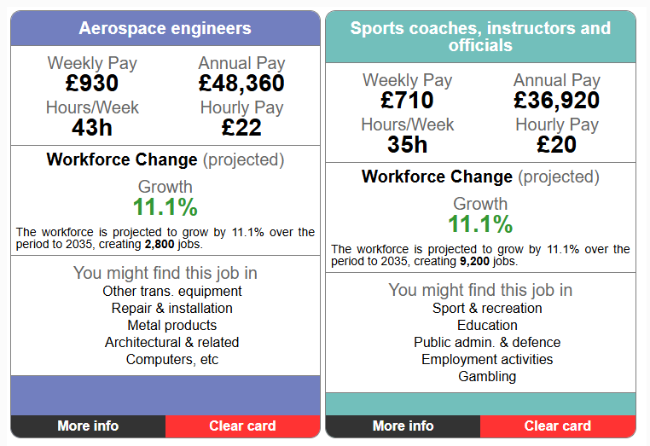
Labour Market Information (LMI)
Careers
Rushey Mead Academy website – Parents – Careers Guidance – Parent/Carer area – Labour Market Information – Explore LMI, scroll down to Careerometer
Explore LMI data – LMI For All
RMA Careers vision – To raise the aspirations of all Rushey Mead Academy students to enable them to make a positive difference to our world.

Slide 22

Useful websites
Careers
Careerpilot : Plan your future work & study
Sign In – Unifrog
Explore careers | National Careers Service
Job profiles | Prospects.ac.uk
Image by vectorjuice on Freepik
RMA Careers vision – To raise the aspirations of all Rushey Mead Academy students to enable them to make a positive difference to our world.

