Slide 1

WELCOME TO LEBC WORK EXPERIENCE

Slide 2
Who are LEBC?
A Charity opening up career opportunities for young people by connecting businesses with schools and colleges for over 30 years. LEBC’s services helps future generations transition from education to the workplace by providing careers guidance, employer encounters and Work Experience with employers looking to find talent
LEBC works with:
🏫 Schools & colleges
👩‍🎓 Young people
🏢 Employers
👨‍👩‍👧 Parents & carers
Our role is to bring everyone together to create safe, meaningful workplace experiences.

Slide 3

WHAT IS WORK EXPERIENCE?
  Students will spend 1 week with a business/ employer.
  typically mon - fri but days and times are dependent on the employer
  Students choose where they attend
Students will be going out W/C -
21st to 25th
June 2027

Slide 4
WHY IS WORK EXPERIENCE IMPORTANT?
  It helps develop crucial skills that they need for their further education, apprenticeships or any work opportunities.
  It is needed on applications - College, University, Part time roles, Apprenticeships (all will ask what Work Experience they have)
  It will help get them out of their comfort zone and increase their confidence
  It is a great opportunity for young people to experience realistic working expectations
  A great chance for young people to start networking in their local community

Slide 5
THE WORK EXPERIENCE JOURNEY

Slide 6
STEP 1 - STUDENTS TO COMPLETE FORMS
Self-Placement
Student to find their own placement. - these are called Self-Placements & are highly advised.
Self-Placement forms are given out to students in school. These need to be completed and returned to school by Friday 6th November 2026
It is important that this date is stuck to as much as possible to avoid delays.

Slide 7
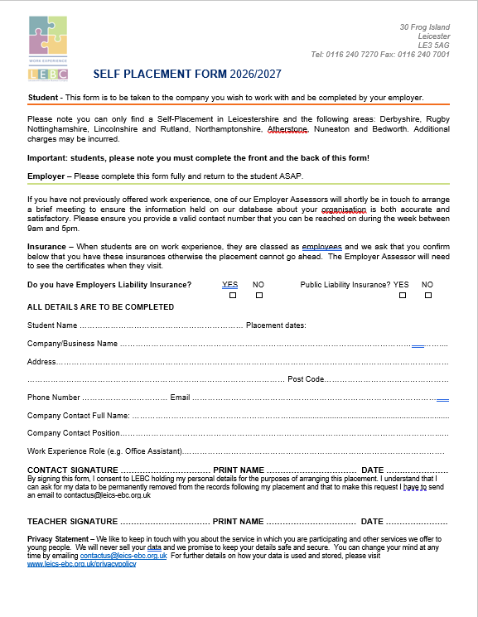
STEP 1 - STUDENTS TO COMPLETE FORMS
SELF-PLACEMENTS
  Students should think about where they want to go on placement. With a family member, to their local shop, anything specific they have in mind.
  They should then contact that employer asking if they can accommodate them for work experience.
  If the employer is happy to accommodate then the employer needs to complete this side of the Self-Placement Form in full. Any missing info will result in a delay.
  Employers must have Employers Liability Insurance. LEBC cannot process placements that do not have this insurance.
  Self-Placements - THEIR CHOICE!

Slide 8
STEP 2 - LEBC BEHIND THE SCENES - H&S
To ensure students are in safe hands, our assessors:
  Are qualified to NEBOSH or IOSH standard depending on the risk level of the placement that we are checking
  Work closely with other partners including LADO and safeguarding in education teams across the City and County
  Visit all placements to check insurances, health, safety and welfare are suitable prior to students attending a placement
  Assist in any investigation needed if a student reports concerns or an incident whilst on their placement
  Check all safeguarding aspects of a placement and advise if a DBS check should be considered
  Ask all employers to sign a letter of understanding so they are aware of their responsibilities when they have a student on placement
  Will work with local agencies regarding concerns raised and the ongoing suitability for that placement
Health & Safety is at the heart of the process.
Before a placement takes place, LEBC considers:
  Workplace risks
  Young-person-specific risks
  Supervision
  Activities the student will undertake
  Safeguarding
  Emergency arrangements
  Employer responsibilities
  Appropriate control measures
We may get in touch if we are struggling to get in contact with an Employer (Self-Placement)

Slide 9
STEP 3 - PAPERWORK COMES INTO SCHOOL
  Approx. 6 weeks before the placement is due to start, LEBC will provide the school with the Learners’ paperwork.
  There are different types of paperwork that the Learners can recieve.
  If the placement is ready to go, students will receive Confirmed paperwork.
  If the placement is awaiting a H&S visit or any insurances, students will recieve a letter stating this.
  If we have been unable to place the student, they will receive a letter with next steps.

Slide 10
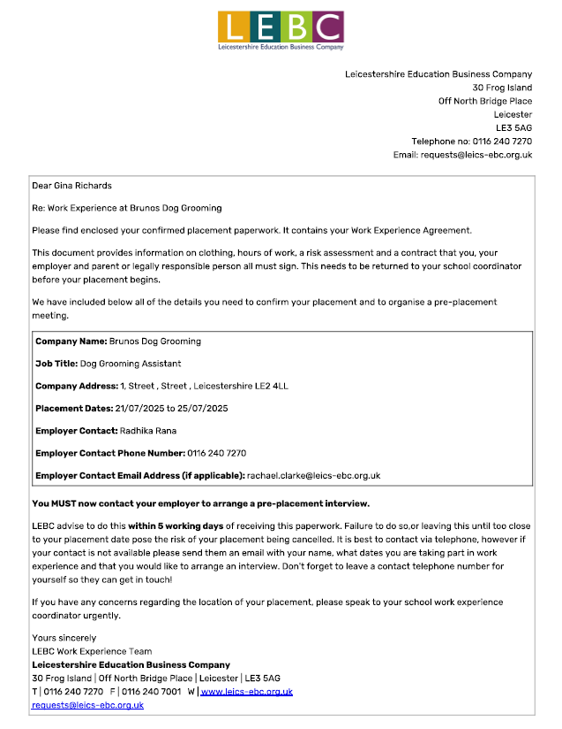
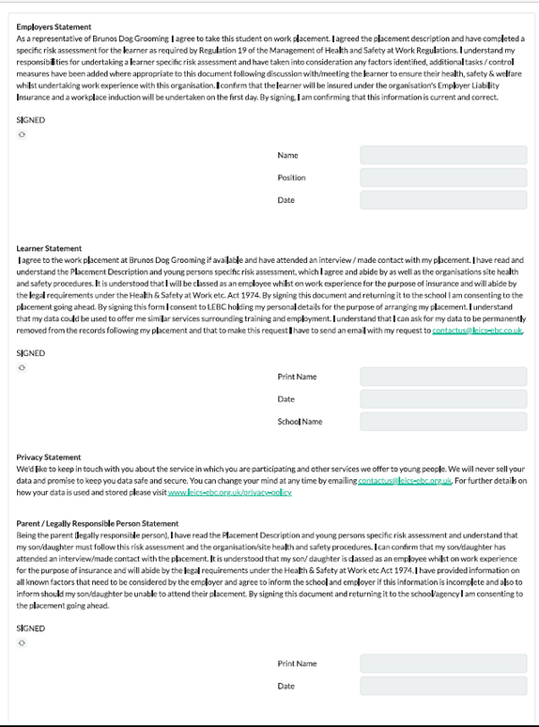
STEP 3 - CONFIRMED STUDENT PAPERWORK
  Students will receive a Cover Letter that clearly states the name of the employer, the job title, the address, contact number and email.
  Students need to use this information to call their employer to arrange a pre-placement interview.
  At the interview/ meeting, they need to get their paperwork signed.
  Students will receive the full risk assessment which has a signature page at the back. Students need to get all signatures and return the document back to school before the placement starts.
  If students do not attend a pre-placement meet/ interview their placement is at risk of being cancelled.

Slide 11
STEP 3 - CONFIRMED STUDENT PAPERWORK
  Parents SHOULD NOT be calling employers on behalf of their students.
  If students need support, they should ask their school.
  Employers do not appreciate when parents call them to arrange - they want to hear from the students.

Slide 12
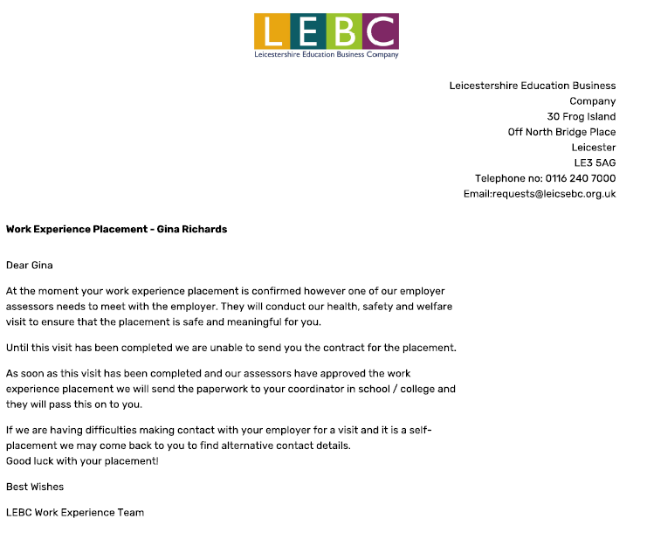
STEP 3 - AWAITING H&S INFO LETTER
  If a student has been confirmed to a placement but the Health & Safety Visit still needs to take place, learners will receive a Letter to let them know this.
  If we are struggling to contact their Self-Placement employer, we may ask you for additional contact information
  Sometimes we are unable to see the Employers Liability Insurance at the time of a Health & Safety visit, so LEBC will be chasing employers to see this. If we are still waiting to see this, Learners will get a letter to clarify this.
  Once visits have taken place, and we have received the Employers Liability Insurance, we will send the Students Confirmed Paperwork to School.

Slide 13

STEP 4 - GETTING READY FOR PLACEMENT
  Once your young person has received their confirmed paperwork, had their interview and got their paperwork signed, they will be ready to start their experience!
  Students should make sure they have worked out how they are getting to placement and confirm with their employer what time to arrive on the first day.

Slide 14

ATTENDANCE MATTERS!
If they say they’re going to attend - they need to attend!
Employers have planned their working day around having a young person with them.
If your young person is unable to attend make sure you are letting the relevant people know ahead of time if applicable!
  School
  Employer
Don’t just stay at home and not let anyone know.
Changes to dates/hours must be agreed.
Students should never independently change their working arrangements with an employer.

Slide 15
Your Role as a
Parent/Carer
Support → Encourage → Empower
You can help by:
💚 Helping them prepare
🗺️ Helping them plan their journey
⏰ Encouraging punctuality
👔 Helping them think about appropriate clothing
💬 Encouraging them to communicate independently
❓ Helping them think of questions
🌟 Encouraging them when they're nervous
We want young people to become independent and confident in the workplace.

Slide 16
WHAT HAPPENS AFTER WORK EXPERIENCE?
The experience doesn't end when they leave the workplace.
Encourage your young person to think about:
  What did I learn?
  What did I enjoy?
  What skills did I develop?
  What surprised me?
  Would I want to do this career in the future?
They can then use the experience when discussing:
🎓 College
🎓 University
💼 Apprenticeships
📄 CVs

Slide 17
PARENTS' MOST ASKED QUESTIONS 🤔
Can they change their placement?
No, students should not change their placement. If they are not happy with their placement, please try to encourage them to give it a go. It is all about getting skills and experience. If they do not attend, they will miss out!!
What should they wear?
Students should read their confirmed paperwork. On here it will tell them what they need to wear. Some placements may ask them to wear specific safety boots (mechanics etc)
Can they do a placement with a family member?
Yes! Students can go on placement with family members if the employer/business has the correct insurances.
What happens if we can’t get in touch with the employer for a pre-placement interview?
Please let the school know. They will pass this to LEBC and we can assist in contacting the employer.

Slide 18
PARENTS' MOST ASKED QUESTIONS 🤔
Does it matter if the work placement isn’t what they want to do in the future?
No! Work Experience is all about gaining valuable skills & having something to put on future applications. If your young person wants to be a lawer, they do not specifically have to do a placement in law. They could do a placement in a school and still gain all the experience and knowledge that colleges and apprenticeships want to see.
What happens if my young person isn’t enjoying the placement?
Encourage them to carry on! If they stick to it they will gain resilience which is an amazing skill to have. Ecourage them to ask their employer for more tasks, or anything that could better their experience.

